Slide 1
Management 515
Managing in the Global Environment
© 2015, 2016 David E. Frick.
All rights reserved.

Slide 2
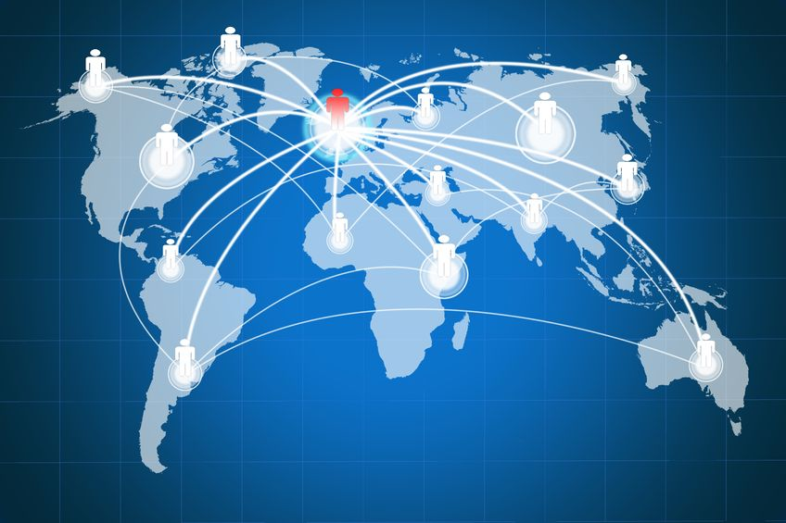
GLOBALIZATION
Notes:
There was a time when most regions were economically self-sufficient. Locally produced foods, fuels and raw materials were generally processed for local consumption. Trade between different regions was quite limited.
Today, the economies of most countries are so interconnected that they form part of a single, interdependent global economy. Globalization refers to rapid increase in the share of economic activity taking place across national borders.
Globalization goes beyond international trade. It includes the way in which goods and services are produced, created, delivered, and sold and the movement of labor, raw materials, and capital.

Slide 3
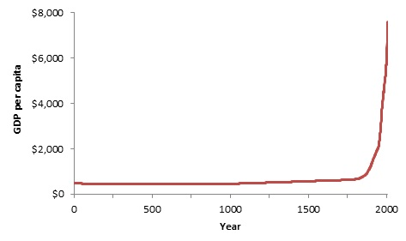
World Per Capita Income
Notes:
Here is a graph of world-wide per capita income since the year zero.
Note the inflection just after 1800? What caused this inflection?
This is several decades after the establishment of the United States. The colonial naval powers of England and Spain are diminished. The trade barriers put in place by these countries are largely gone. The economic strangle hold of Denmark is gone. France is coming out of its own revolution and not focused on international affairs.
International trade is advancing because the in advances in technology (larger, more seaworthy ships) and fewer trade barriers.
Increases in international trade have a direct positive impact on the incomes of nations.

Slide 4

Definitions
Global Organization. An organization that operates and competes in more than one country
Global Environment. Set of forces and conditions in the world outside the organization’s boundaries that affect the way it operates and shape its behavior
Economic
Technological
Socio-cultural
Demographic
Political
Laws and regulations
Notes:
The international business environment can be defined as the environment in different sovereign countries, with factors exogenous to the home environment of the organization, influencing decision making on resource use and capabilities.
The external environment includes the social, political, economic, regulatory, tax, cultural, legal, and technological environments. To function effectively and efficiently, firms operating internationally must understand the social environment of the host country in which they are operating.
Today there are thousands of multinational corporations which operate in many parts of the globe.

Slide 5
More Definitions
Global Outsourcing. The purchase or production of inputs or final products from overseas suppliers to lower costs and improve product quality or design
Globalization. The set of specific and general forces that work together to integrate and connect economic, political, and social systems across countries, cultures, or geographical regions so that nations become increasingly interdependent and similar
Notes:
Outsourcing has acquired a negative connotation for many people. In most cases, those most directly affected by the consequences of outsourcing are the most vocal opponents.
If you look at outsourcing dispassionately, it is nothing more than conducting business operations in the most cost-effective manner. It is not until these business actions cross national borders do people get upset. Efficient business operations leads to economic profit, which is better for society. So outsourcing is good for the many, but can be bad for a few. These few tend to be vocal.
This gives politicians an opportunity to use conflict to their own benefit. Companies that outsource are characterized as evil and money grubbing with executives who don’t care about their employees. The reality is that, in most cases, outsourcing is just good business.

Slide 6
Barriers to Global Entry
Economies of scale. Cost advantages with large operations in one location
Brand loyalty. Customers’ preference for products may not be seen in other countries or cultures
Distance. Markets can be essentially closed because of the costs of communications/transportation over long distances
Culture. Language barriers and cultural practices can make managing overseas businesses difficult
Tariffs. A tax that government imposes on imported or, occasionally, exported goods. Intended to protect domestic industry and jobs from foreign competition
Notes:
Companies can face barriers to creating a global footprint.
Even if a business can overcome all of the barriers within it power to influence, tax policy may be insurmountable. As governments change, tariff policy can change making previously profitable business suddenly unprofitable.

Slide 7
General Global Environment
Socio-cultural Forces. Pressures emanating from the social structure of a country or society or from the national culture
Social structure. The traditional system of relationships established between people and groups in a society
National culture. The set of values that a society considers important and the norms of behavior that are approved or sanctioned in that society
Technology. Electronic equipment that managers use in to achieve desired outcomes—United States vs. rest of world
Notes:
Despite all of the challenges facing business, globalization can be a good thing. The free flow of labor and goods across borders tends to benefit all countries involved.
Advances in technology offer the greatest potential for business to expand into the global environment. With a few exceptions, electrons are allowed to flow across borders unfettered.

Slide 8
General Global Environment
Economic Forces. Interest rates, inflation, unemployment, economic growth, and other factors that affect the general health and well-being of a nation or the regional economy of an organization
Demographic Forces. Outcomes of changing attitudes toward, the characteristics of a population, such as age, gender, ethnic origin, race, sexual orientation, and social class
Political and Legal Forces. Outcomes of changes in laws and regulations, such as deregulation of industries, privatization of organizations, and increased emphasis on environmental protection.
Notes:
Economic conditions can greatly affect the ability to conduct business in other countries. For example, the European Union, which was intended to reduce barriers to member nations, has had other consequences. The bad economies of Greece, Spain, and Italy have reduced opportunities for companies wanting to do business in England, Germany, and France.
The mass migration of displaced emigrants from the Middle East into Europe had driven up social costs which governments want to pass along to businesses.
Governments can even nationalize business assets. That is what happened in Venezuela. Businesses lost all of their assets in just a few months.

Slide 9
Process of Globalization
Human capital. The flow of people around the world through immigration, migration, and emigration
Financial capital. The flow of money capital across world markets through overseas investment, credit, lending, and aid
Resource capital. The flow of natural resources, parts, and components between companies and countries, such as metals, minerals, lumber, energy, food products, information technology, and repair parts
Political capital. The flow of influence using diplomacy, persuasion, aggression, and force of arms to protect the access of a country to the forms of capital in other countries
Notes:
As I said previously, the free flow of labor, capital, and resources tends to benefit all countries involved. Sadly, when politicians get involved, barriers tend to grow. Many politicians have very short-sighted views of the world and do not see the consequences of creating barriers to global commerce.

Slide 10
Changes to the Global Environment
Changes in Distance and Communication. Improvement in transportation technology and fast, secure communications have greatly reduced the barriers of physical and cultural distances
Lowering of Trade Barriers. Opened enormous opportunities for managers to expand the market for their goods and services. Allowed managers to now both buy and sell goods and services globally. Increased intensity of global competition such that managers now have a more dynamic and exciting job of managing

Slide 11
National Culture
Values. Ideas about what a society believes to be good, right, desirable and beautiful. Provide the basic underpinnings for notions of individual freedom, democracy, truth, justice, honesty, loyalty, love, sex, marriage, etc.
Norms. Unwritten, informal codes of conduct that prescribe how people should act in particular situations and are considered important by most members of a group or organization
Folkways. Routine social conventions of daily life (e.g., dress codes and social manners)
Mores. Behavioral norms that are considered central to functioning of society and much more significant than folkways (e.g., theft and adultery), and they are often enacted into law.
Notes:
The national culture has a very large affect on the ability of firms to conduct business in foreign lands. Differences between cultures may have an effect on how to effectively manage foreign employees and manage foreign stakeholders. These differences may create managerial challenges for companies. Differences between national cultures are mainly found in the deep rooted values of the respective cultures. These cultural values can shape how people expect companies to be run, and how relationships between leaders and followers should be. Ideally, these expectations are balanced between the employer and the employee, but many times the cultural distance results in great differences that can cause problems for the management.
When employing people from different cultural backgrounds, companies may benefit from trying to generate a unified organizational culture. Employees from other national cultures can be socialized into the culture of the respective company, and hence learn the practices of the respective corporate culture, even though these practices might be contradictory to the practices normally found in the employee's national culture. However, if the company practices are very different from cultural norms, this can be very hard, if not impossible.
Companies like McDonalds want to create a uniform corporate culture, to strengthen its world-wide image and maintain universal quality. Nonetheless, even McDonalds tailors its menu and pricing to accommodate local cultural norms.

Slide 12

Global Environmental Analysis
Economic or social factors play a big role in a company’s decisions. This analysis and the monitoring of those factors reveal chances and risks for the company’s business. This analysis can be conducted at the macro and micro level
PESTLE analysis
Political
Economic
Social
Technological
Legal
Environmental
Notes:
When exploring whether a business wants to expand into a foreign market, models such as Porter’s Five Forces, SWOT, and PEST (or PESTLE) can be useful.
View this video: https://www.youtube.com/watch?v=mCdcdf-b8AU
View this video: https://www.youtube.com/watch?v=4mkVc6ZZtJw

Slide 13
Advantages of a Global Environment
Access to labor
Knowledge, skills, abilities
Cost of labor
Access to natural resources. Partnerships with governments may results in access to otherwise unavailable rare natural resources
Reduced transportation costs. Collocating manufacturing with raw materials can reduce costs and strengthen supply chain
Tax advantages. Many countries have favorable tax laws
Notes:
Positive effects
--Increased economic development in the host country
--Expanded infrastructure in the host country
--Transfer of modern management techniques to emerging economies
--Greater interdependence among business partners. Some argue that economic interdependence leads to improved conditions for lasting peaceful conditions
Negative effects
--Increases the power of MNC. Many fear this rising power
--MNCs externalize cost to countries, e.g., use low cost, polluting processes that would not be allowed in home country
--Competition results in too many concessions. Host countries may give breaks to MNC that end up hurting the local population
--MNCs may influence local policies to the detriment of the local population
--Companies incorporate in low tax countries which removes tax revenues from home countries

Slide 14

Impact on labor in host country
Positive
Increased job opportunities
Upgraded education system
More access to training
Negative
Job displacement
Lower labor standards
Downward wage pressure
Exploitation of workers
Notes:
In the global economy jobs are becoming more temporary and insecure.
A survey of American workers showed that millennials can expect to hold 7 to 10 jobs over their working life. This may be more a function of the changing cultural norms; however, one can argue that the access to foreign workers can increase the likelihood of American workers being displaced.

Slide 15
Economic Considerations
Currency Exchange
Most countries demand payment in their own currency
An increasing exception is crude oil
Trade Balance
Capital inflows and outflows
United States has been running a trade deficit for decades
Tariffs, quotas, and embargos
Free trade areas
Notes:
Some argue that globalization leads to growing inequality in economic development. Corporate profits have grown in the richest countries, which stunts economic development in host countries.
Increased likelihood of economic disruptions in one nation can affect all nations
The fact that some economies are benefiting more than others does not necessarily mean that workers from those benefiting economies are seeing an improvement in their own quality of life, income, or economic standing

Slide 16
Social and Political Concerns
Political Stability
Governments change
Civil unrest and war is not healthy for all business
Universal Human Rights
Cultural norms of one country may be considered a human rights violation in another
One-size-fits-all policies may not fit all
Environmental Impact. Varying environmental standards may have an impact on the firm’s image at home
Notes:
Globalization can lead to rapid trends of urbanization in host countries. This may create an urban population more vulnerable to hunger, isolation, exploitation, and disease
Native cultures are being erased at a rapid rate
Globalization leads to a greater risk of diseases being transported unintentionally between nations, increase in the chances of civil war within developing countries, and open war between developing countries as they vie for resources
Decreases in environmental integrity can lead to polluting corporations taking advantage of weak regulatory rules in developing countries
The threat that control of world media by a handful of corporations will limit cultural expression
International aid sources have decreased while those agencies which dispense aid have come increasingly under the control of the richest economies
Globalization is here to stay. I think it is a good thing. Some are concerned, even fearful. You can decide for yourself.

